Slide 1
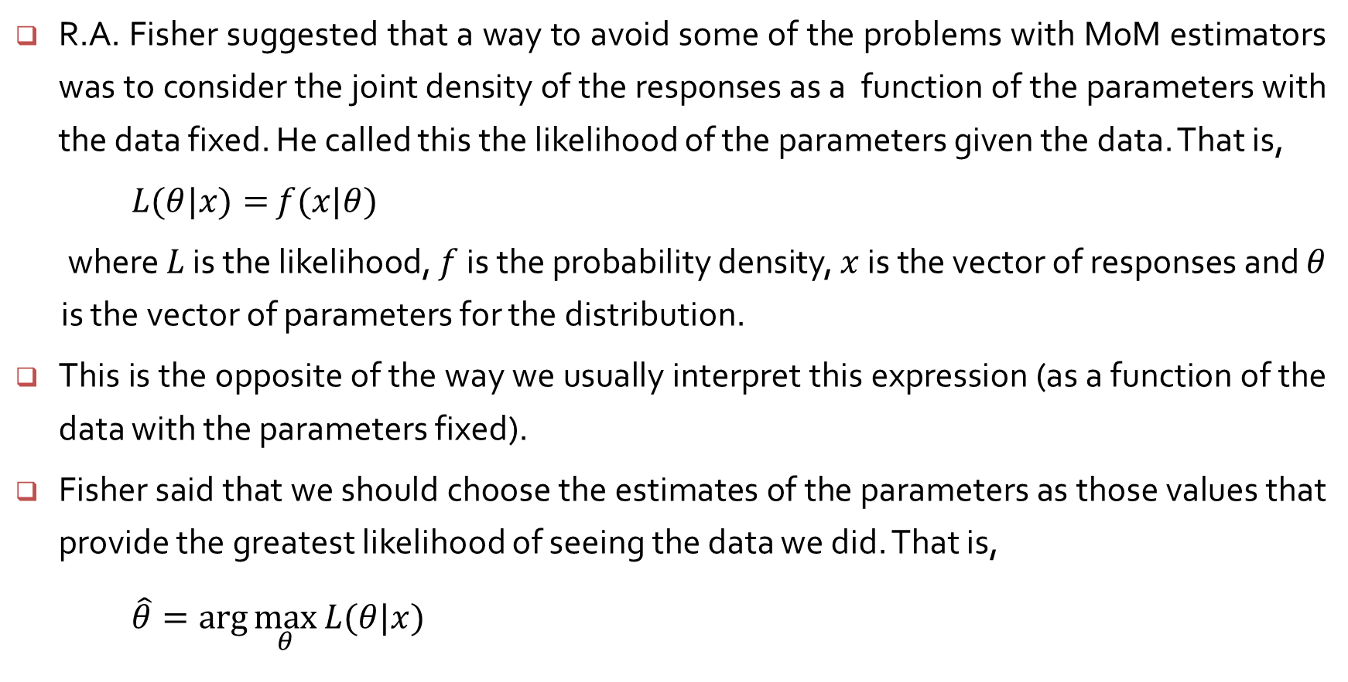
Maximum likelihood estimators
R.A. Fisher suggested that a way to avoid some of the problems with MoM estimators was to consider the joint density of the responses as a function of the parameters with the data fixed. He called this the likelihood of the parameters given the data. That is,
$L(θ|x)=$ $f(x|θ)$
where $L$ is the likelihood, $f$ is the probability density, $x$ is the vector of responses and $θ$ is the vector of parameters for the distribution.
This is the opposite of the way we usually interpret this expression (as a function of the data with the parameters fixed).
Fisher said that we should choose the estimates of the parameters as those values that provide the greatest likelihood of seeing the data we did. That is,
$\hat{θ}=\arg{\max_{θ}{L(θ|x)}}$

Slide 2
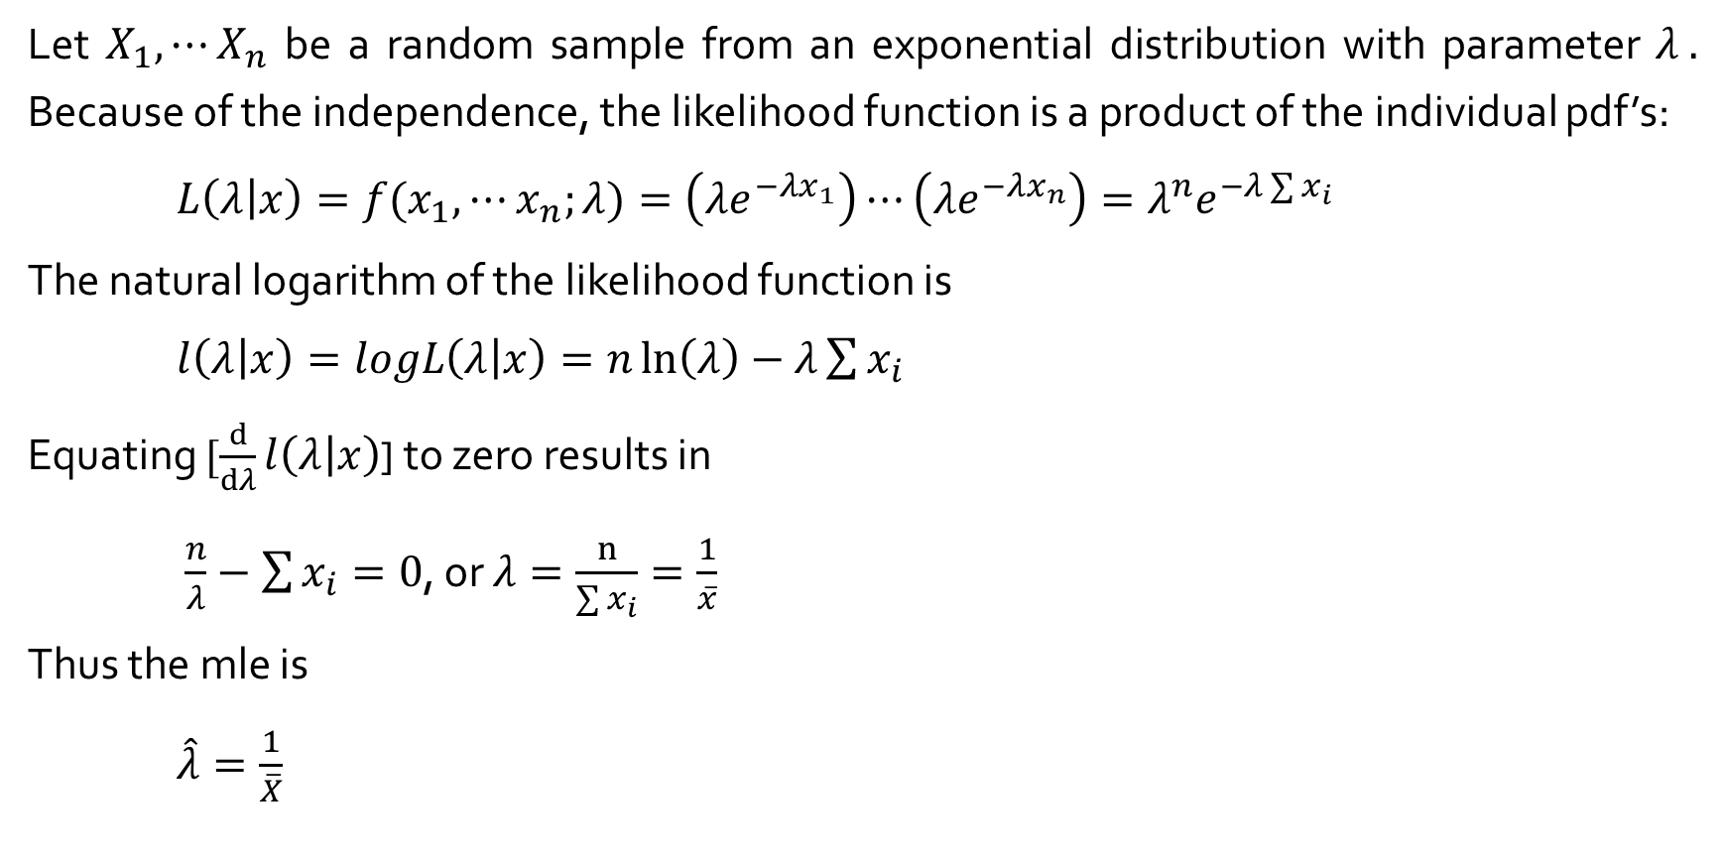
Maximum Likelihood Estimation – Example 6.16
Let $X_{1}, ⋯X_{n}$ be a random sample from an exponential distribution with parameter $λ .$ Because of the independence, the likelihood function is a product of the individual pdf’s:
${L\left(λ | x\right)=f(x}_{1}, ⋯x_{n};λ)=\left(λe^{−λx_{1}}\right)⋯\left(λe^{−λx_{n}}\right)=λ^{n}e^{−λ\sum{x_{i}}}$
The natural logarithm of the likelihood function is
$l\left(λ | x\right)=logL\left(λ | x\right)=n\ln\left(λ\right)−λ\sum{x_{i}}$
Equating $[\frac{d}{dλ}l\left(λ | x\right)$] to zero results in
$\frac{n}{λ}−\sum{x_{i}}=0$, or $λ=\frac{n}{\sum{x_{i}}}=\frac{1}{\overline{x}}$
Thus the mle is
$\hat{λ}=\frac{1}{\overline{X}}$

Slide 3
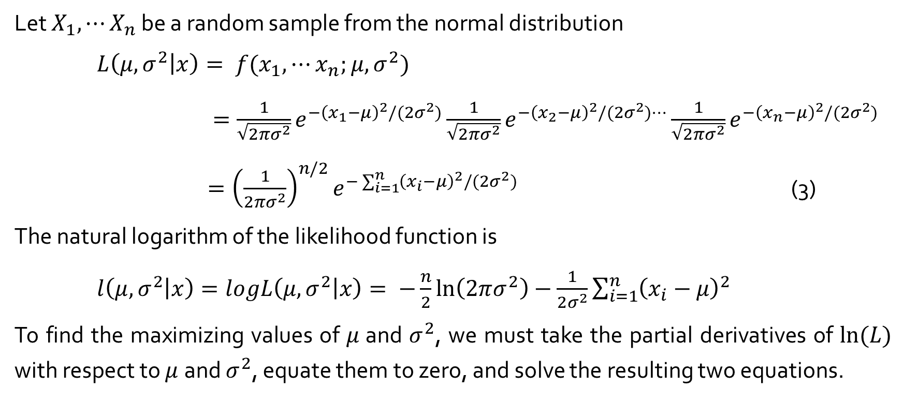
Maximum Likelihood Estimation – Example 6.17
Let $X_{1}, ⋯X_{n}$ be a random sample from the normal distribution
$L\left(μ,σ^{2} | x\right)= {f(x}_{1}, ⋯x_{n};$ $μ,σ^{2})$
$=\frac{1}{\sqrt{2πσ^{2}}}e^{−{\left(x_{1}−μ\right)}^{2}/(2σ^{2})}\frac{1}{\sqrt{2πσ^{2}}}e^{−{\left(x_{2}−μ\right)}^{2}/(2σ^{2})⋯}\frac{1}{\sqrt{2πσ^{2}}}e^{−{\left(x_{n}−μ\right)}^{2}/(2σ^{2})}$
$={\left(\frac{1}{2πσ^{2}}\right)}^{n/2}e^{−\sum_{i=1}^{n}{{\left(x_{i}−μ\right)}^{2}/(2σ^{2})}}$ (3)
The natural logarithm of the likelihood function is
$l\left(μ,σ^{2} | x\right)=logL\left(μ,σ^{2} | x\right)= −\frac{n}{2}\ln\left(2πσ^{2}\right)−\frac{1}{2σ^{2}}\sum_{i=1}^{n}{{\left(x_{i}−μ\right)}^{2}}$
To find the maximizing values of $μ$and $σ^{2}$, we must take the partial derivatives of $ln⁡(L)$ with respect to $μ$and $σ^{2}$, equate them to zero, and solve the resulting two equations.

Slide 4
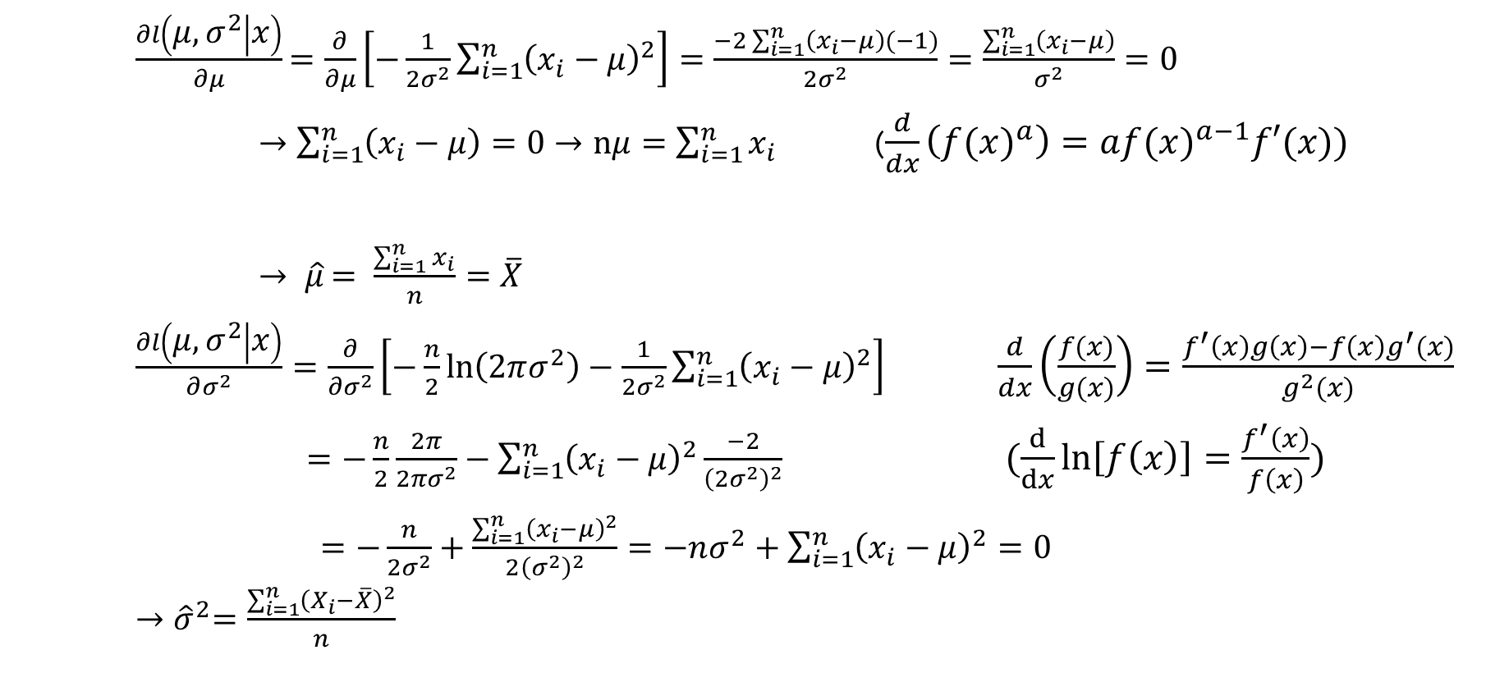
Maximum Likelihood Estimation – Example 6.17
$\frac{∂l\left(μ,σ^{2} | x\right)}{∂μ}$ $=\frac{∂}{∂μ}\left[−\frac{1}{2σ^{2}}\sum_{i=1}^{n}{{\left(x_{i}−μ\right)}^{2}}\right]=\frac{−2\sum_{i=1}^{n}{\left(x_{i}−μ\right)(−1)}}{2σ^{2}}=\frac{\sum_{i=1}^{n}{\left(x_{i}−μ\right)}}{σ^{2}}=0$
$→\sum_{i=1}^{n}{\left(x_{i}−μ\right)}=0→nμ=\sum_{i=1}^{n}{x_{i}}$ ($\frac{d}{dx}\left({f(x)}^{a}\right)=a{f(x)}^{a−1}f′(x))$
$→ \hat{μ}$ $= \frac{\sum_{i=1}^{n}{x_{i}}}{n}=\overline{X}$
$\frac{∂l\left(μ,σ^{2} | x\right)}{∂σ^{2}}=\frac{∂}{∂σ^{2}}\left[−\frac{n}{2}\ln\left(2πσ^{2}\right)−\frac{1}{2σ^{2}}\sum_{i=1}^{n}{{\left(x_{i}−μ\right)}^{2}}\right]$ $\frac{d}{dx}\left(\frac{f(x)}{g(x)}\right)=\frac{f^{′}\left(x\right)g\left(x\right)−f\left(x\right)g^{′}(x)}{g^{2}(x)}$
$=−\frac{n}{2}\frac{2π}{2{πσ}^{2}}−\sum_{i=1}^{n}{{\left(x_{i}−μ\right)}^{2}}\frac{−2}{{\left(2σ^{2}\right)}^{2}}$ $(\frac{d}{dx}\ln\left[f\left(x\right)\right]=\frac{f^{′}\left(x\right)}{f\left(x\right)})$
$=−\frac{n}{2σ^{2}}+\frac{\sum_{i=1}^{n}{{\left(x_{i}−μ\right)}^{2}}}{2{\left(σ^{2}\right)}^{2}}=−nσ^{2}+\sum_{i=1}^{n}{{\left(x_{i}−μ\right)}^{2}}=0$ ${→\hat{σ}}^{2}=\frac{\sum_{i=1}^{n}{{\left(X_{i}−\overline{X}\right)}^{2}}}{n}$

